Slide 1
Creating A Classroom Where Struggling Readers Succeed: K-5
Kathi Rhodus
krhodus@isbe.net
ISBE ELA Content Specialist

Slide 2
Today’s Goals
1. Foundational Skills – Ample Practice for Struggling Students
2. Scaffolded Instruction - Gradual Release of Responsibility Approach
a. Read Alouds
b. Shared Reading
c. Guided Reading
d. Independent Reading
3. Building Stamina

Slide 3
3 Takeaways from the Session
Can be resources or ideas or next steps.

Slide 4
Struggling students
A struggling learner is a student who has difficulty keeping up with classmates of the same age in a developmentally appropriate learning environment.

Slide 5
Struggling readers…
KNOW they struggle with reading
Do anything they can to distance themselves from the place and the people who will remind them that they can’t read.

Slide 6
Struggling readers…
Prefer to get into trouble for not doing their work rather than be embarrassed in front of their peers for doing it wrong.

Slide 7
Do we know why They struggle?

Slide 8
1. Foundational Skills – Ample Practice for Struggling Students
2. Scaffolded Instruction = Gradual Release of Responsibility Approach
a. Read Alouds
b. Shared Reading
c. Guided Reading
d. Independent Reading
3. Building Stamina
4. Scaffolding Cautions, Strategies, Tips and Tools

Slide 9
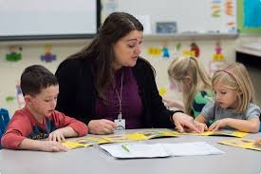
Foundations of Reading: Foundational Skills
Students who do not reach proficiency levels on the first exposures to the foundations of reading will need MORE exposures and experiences. Otherwise, they risk becoming the students who are reading five (or more) years below grade level in high school – the ones who rarely graduate.
(Hernandez, 2001)

Slide 10
Quick Alignment Checklists for Foundational Skills (K-5)

Slide 11
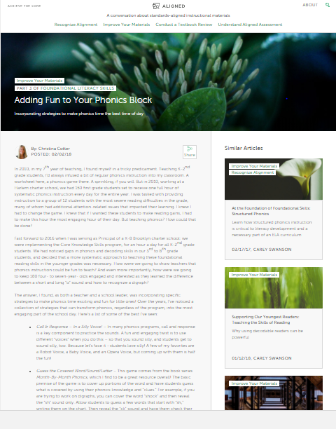
Student Achievement Partner Resources: www.achievethecore.org
Professional Development, etc..
https://achievethecore.org/category/1206/ela-literacy-foundational-skills

Slide 12
Illinois literacy in action Resources www.illinoisliteracyinaction.org
Choose a grade level
2. Click Foundational Skills

Slide 13
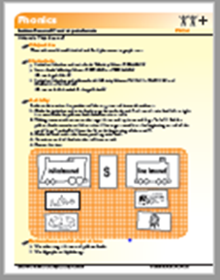
Resources
Building the Foundation
Florida Center for Reading Research Activities
Progression of Skills
http://www.readingrockets.org/sites/default/files/Building%20the%20Foundation.pdf
http://www.fcrr.org/curriculum/SCA_CCSS_index.shtm

Slide 14
Don’t let the Schedule Keep Struggling Readers from Getting What they Need!
Be careful that RtI Programs and Title Programs are not adding more stress to the struggling reader.
These programs should work in tandem with the regular classroom and not add to the number of things students have to do in a school day.

Slide 15
1. Foundational Skills – Ample Practice for Struggling Students
2. Scaffolded Instruction - Gradual Release of Responsibility Approach
a. Read Alouds
b. Shared Reading
c. Guided Reading
d. Independent Reading
3. Building Stamina

Slide 16
Scaffolding challenges
Scaffolds NOT gradually removed
Scaffolds not removed

Slide 17
Gradual Release of Responsibility
Teacher | Read Aloud | Shared Reading | Guided Reading | Independent Reading
Student

Slide 18
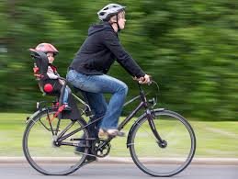
Read Alouds
Reading aloud is the foundation for literacy development.
It is the single most important activity for reading success (Bredekamp, Copple, & Neuman, 2000).
It provides children with a demonstration of phrased, fluent reading (Fountas & Pinnell, 1996).
It reveals the rewards of reading, and develops the listener's interest in books and desire to be a reader (Mooney, 1990).

Slide 19
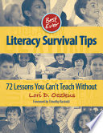
Best Ever Literacy Survival Tips: 72 Lessons That You Can’t Teach Without By Lori D. Oczkus
Chapter 2:
The Power of Reading Aloud to Your Students: Guidelines and Top 5 Read-Aloud Strategies

Slide 20
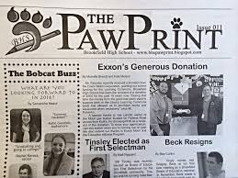
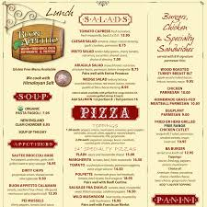
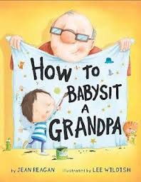
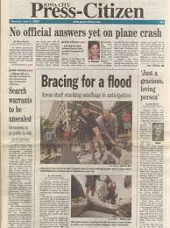
Lori’s Top 5 Surefire Strategies for Reading Aloud
Read Aloud 5-7 Times a Day
One Read-Aloud to Build Comprehension and Stamina (10 min)
The rest are 1-3 minute “quick reads”

Slide 21
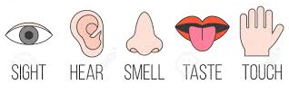
#2: Senses Alert
Bring attention to words, phrases sentences that require them to use their senses.
#3: PartnerTalk/Discussion Starters
Before and after read-alouds
http://www.illinoisliteracyinaction.org/uploads/4/0/7/1/40712613/collaborative_conversation_sentence_stems_f2017.pdf

Slide 22
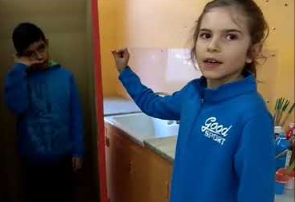
4. Literacy Mystery Boxes
5. Interactive Engagement

Slide 23
Read Aloud Resources
Student Achievement Partners Read aloud project
Teacher’s college Reading and Writing Project
Lessons for read aloud books, grades K–2
https://achievethecore.org/category/411/ela-literacy-lessons?filter_cat=788&sort=name
Suggested Read Aloud Titles – Grades K-8 Interactive Read Aloud With Accountable Talk
http://readingandwritingproject.com/public/resources/booklists/archived/reading/interactive_read_aloud.pdf

Slide 24
Gradual Release of Responsibility
Teacher | Read Alouds | Shared Reading – Next Scaffolding Step | Guided Reading | Independent Reading
Student

Slide 25
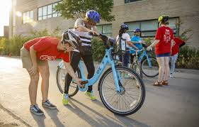
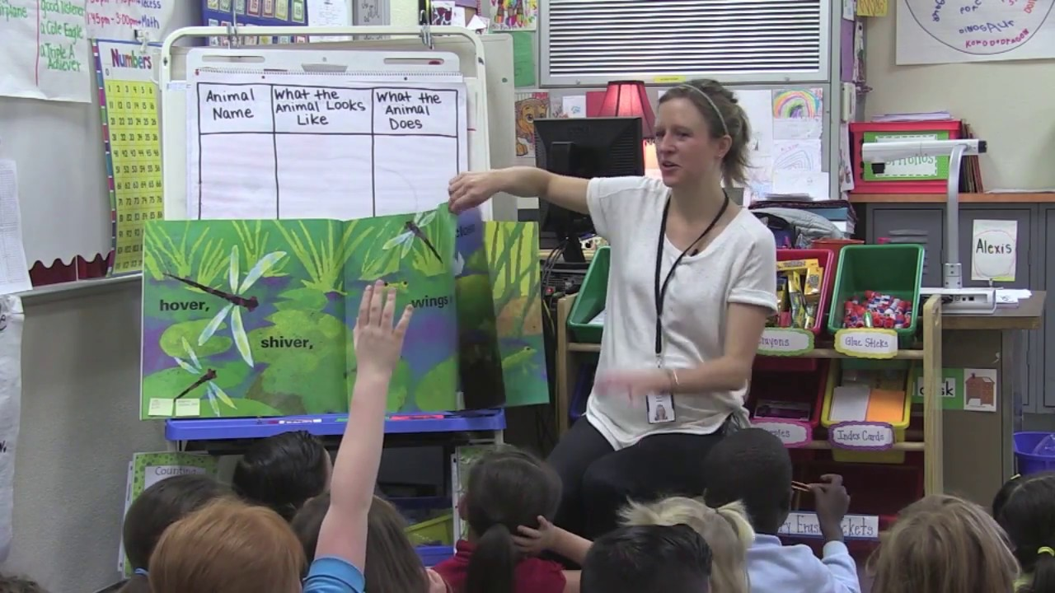
Shared REading
Interactive reading experience
Guided and supported by a teacher
Teacher explicitly models skills
Materials are oversized for all to see (or individual copies are provided)

Slide 26
Gradual Release of Responsibility
Teacher | Read Aloud | Shared Reading | Guided Reading Less Scaffolding | Independent Reading
Student

Slide 27
Research is Clear
Guided reading supports all readers:
Striving
Advanced
Dual Language Learners
(Clay, 1975; Richardson, 2009; Richardson & Walther, 2013; Fountas & Pinnell, 2016)

Slide 28
Guided Reading
Guided reading is strategic, differentiated small-group reading instruction. It’s aim is clear: to help readers
confidently, proficiently, and independently process increasingly challenging texts.
(Richardson, 2016)

Slide 29
Guided Reading
Giving them what they need!

Slide 30
Gradual Release of Responsibility
Teacher | Read Aloud | Shared Reading | Guided Reading | Independent Reading
Final step of gradual release!
Student

Slide 31
Independent Reading
Unfortunately, in many schools the poorest readers read the least, often as much as three times less than their peers (Allington, 2006).

Slide 32
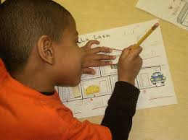
At-Risk Readers Need time to read
Isolated skills instruction has become the primary focus of the struggling student, but they do very little reading.
“If they don’t read much, how they ever gonna get good?”
(Allington, 2009)
Notes:
Struggling readers need precisely what good readers receive – lots of high-success reading experiences

Slide 33
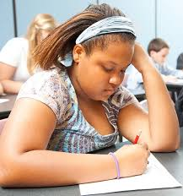
We fill the readers’ days with tasks that require little reading. If we want to foster reading development, then we must design lessons that provide the opportunities for struggling readers to actually read.”
(Allington, 2013)

Slide 34
1. Foundational Skills – Ample Practice for Struggling Students
2. Scaffolded Instruction - Gradual Release of Responsibility Approach
a. Read Alouds
b. Shared Reading
c. Guided Reading
d. Independent Reading
3. Building Stamina

Slide 35
Goal: Building stamina
When students deeply engage with text for sustained periods of time, they enter the “reading zone.” (Atwell, 2007)
Help students build muscle memory around managing space, materials, and attention. (Boushey & Moser, 2014)
Tips
Stop independent reading while it is still engaging.
Continue to do this regularly, incrementally increasing the amount of time before interruption.
Goal for Primary – 15-30 minutes
Goal for Intermediate – 30-45 minutes

Slide 36
Real Reading | Fake Reading
Reading and understanding | Skimming
Reading and thinking | Picture reader
Taking your time | Mumbling
Using strategies | Speed reading
Focused | Flipping pages
Reflect and connect | Stalling

Slide 37
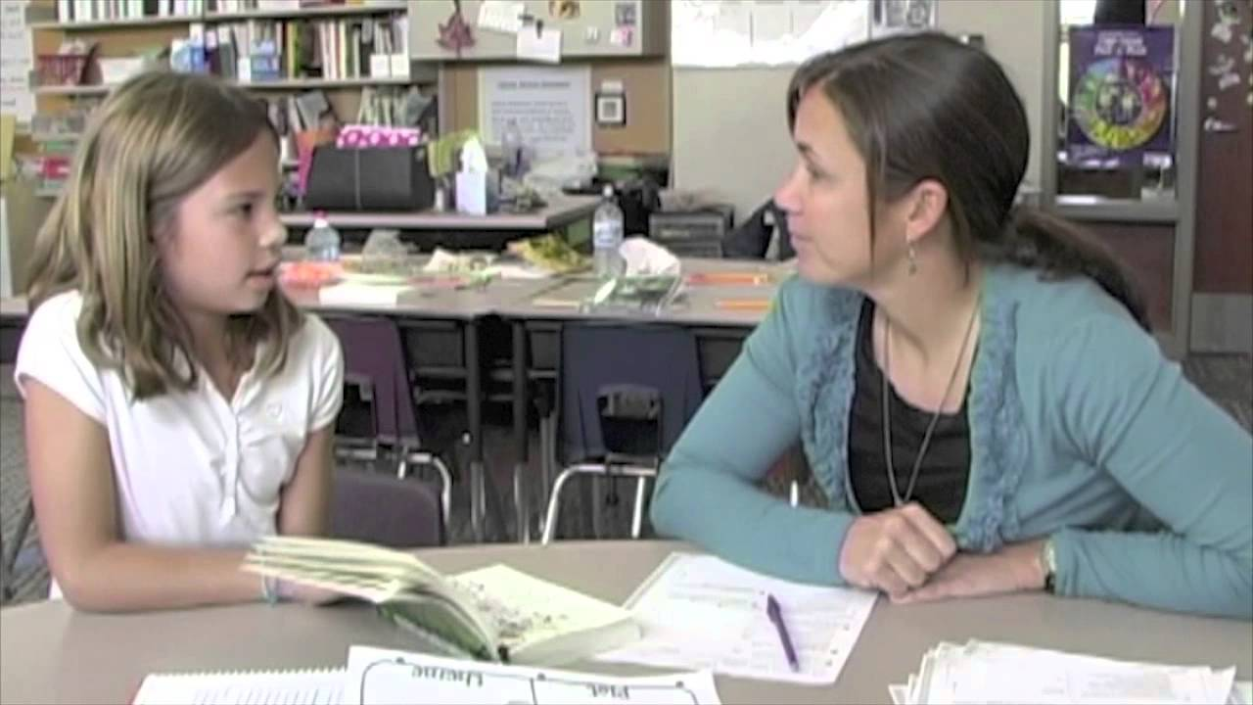
Do NOT sacrifice independent reading time during the school day!
What should teachers do during independent reading time?
Notes:
Observe
Interact
Collect formative assessment data
Independent reading can be “assigned as homework” but it is not to take the place of independent reading during the school day. Gathering formative assessment data during independent reading is essential for future planning.

Slide 38
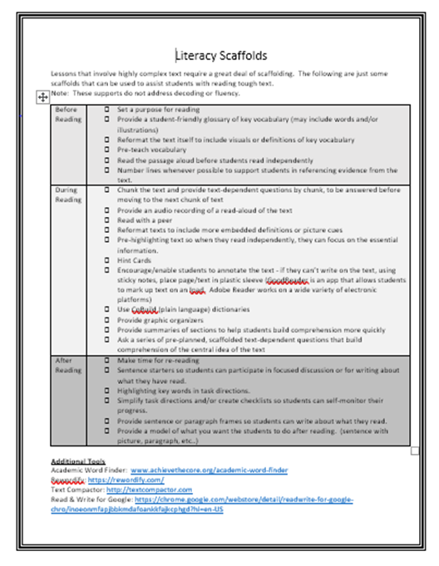
Scaffolding Strategies Tips & Tech tools
Notes:
Supporting students so that they can learn at high levels is central. It is critical that teachers craft lessons that move students to more challenging work while simultaneously providing ongoing scaffolding to support students as they learn. To simply increase expectations without helping students move to those higher levels is inappropriate.

Slide 39
3 Takeaways from the Session
Can be resources or ideas or next steps.

Slide 41
Thank You
Kathi Rhodus
ISBE ELA Content Specialist
krhodus@isbe.net

Slide 42
References
Allington, R.L. (2009), If they don’t read much….30 years later. In E.H. Hiebert (Ed.), Reading more, reading better (pp. 30-54). New York: Guilford Publishers.
Allington, R.L. (2011), What At-Risk Readers Need. Educational Leadership, March 2011, Volume 68, Pages 40-45.
Burkins, Jan Miller, and Kim Yaris. Who’s doing the work?: how to say less so readers can do more. Stenhouse Publishers, 2016.

